Slide 1
SIMPLE PAST TENSE
GEÇMİŞ ZAMAN

Slide 2
OLUMSUZ CÜMLELERDE DIDN’T YARDIMCI FİİLİ VE FİİLİN 1. HALİNİ KULLANIRIZ.
DIDN’T + v1

Slide 3
We walked by the river last Thursday.
We didn’t walk by the river last Thursday.

Slide 4
I played basketball last year.
I didn’t play basketball last year.

Slide 5
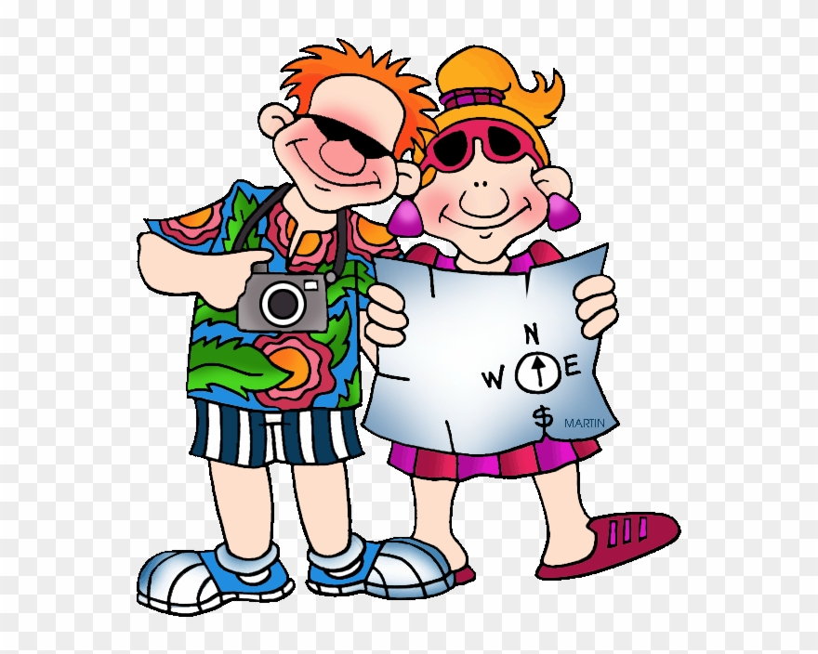
They went sightseeing.
They didn’t go sightseeing.

Slide 6

He watered the flowers on Sunday.
He didn’t water the flowers on Sunday.

Slide 7
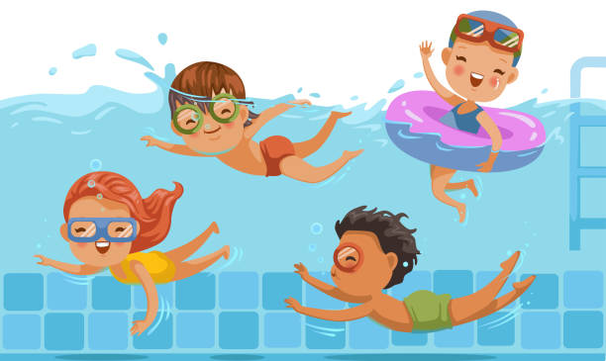
The children swam in the pool.
The children didn’t swim in the pool.

Slide 8
GİZEM ŞEYDA KAYALI

